Slide 1
ABSTRACT

Slide 2
INTRODUCTION
The report is designed to address three intended audiences: the general public, industry, and government.

Slide 3
APPLICATION OF ARTIFICIAL INTELLIGENCE IN VARIOUS
Artificial intelligence (AI) is a field of computer science that focuses on the creation of intelligent machines that can think and act like humans. AI has been applied to a wide range of fields, including transportation, healthcare, finance, and customer service. AI has the potential to revolutionize many industries and improve society as a whole.

Slide 4
Over the next fifteen years coincident advances in mechanical and AI technologies
The rapid advance of artificial intelligence (AI) and robotics has the potential to transform many aspects of society, including healthcare, education, transportation, and the workplace.

Slide 5
innovations still on the horizon have the potential to significantly improve health
The past fifteen years have seen considerable AI advances in education. Over the next fifteen years, the use of intelligent tutors and other AI technologies to assist teachers in the classroom and in the home is likely to expand significantly, as will learning based on virtual reality applications.

Slide 6
Cities already have begun to deploy AI technologies for public safety and security
The report, which was commissioned by the Canadian government, is designed to help cities prepare for the arrival of AI. It predicts that by 2030, AI will be used in most public safety and security applications.

Slide 7
shifted due to a major recession and increasing globalization particularly with
The US has experienced continued growth in productivity and GDP, but median income has stagnated and the employment to population ratio has fallen. AI will likely replace tasks rather than jobs in the near term, and will also create new kinds of jobs.

Slide 8
Through the creation of efficiently outsourced labour markets enabled by AI
The impact of artificial intelligence (AI) on society is expected to be profound. It will have a major impact on the economy, the environment, and the way people live and work. It will also create new opportunities for businesses and entrepreneurs. AI has the potential to improve society and make life better for everyone.

Slide 9
creativity on platforms such as Words Eye which automatically generates D scenes
The use of artificial intelligence in the arts, entertainment, finance, and economics has become widespread. It has also changed major economic theories.

Slide 10
markets again making markets more efficient Other theories where AI has had impact
Artificial intelligence (AI) is having a growing impact on business, and is now being used in areas such as customer service, marketing, and finance. AI is also being used to improve efficiency in supply chain management, and to develop new products and services.

Slide 11
years earlier Most of the investment in AI consists of internal RD spending by large
The global artificial intelligence market is expected to grow from $1. 3 billion in 2018 to $8. 8 billion by 2023.

Slide 12
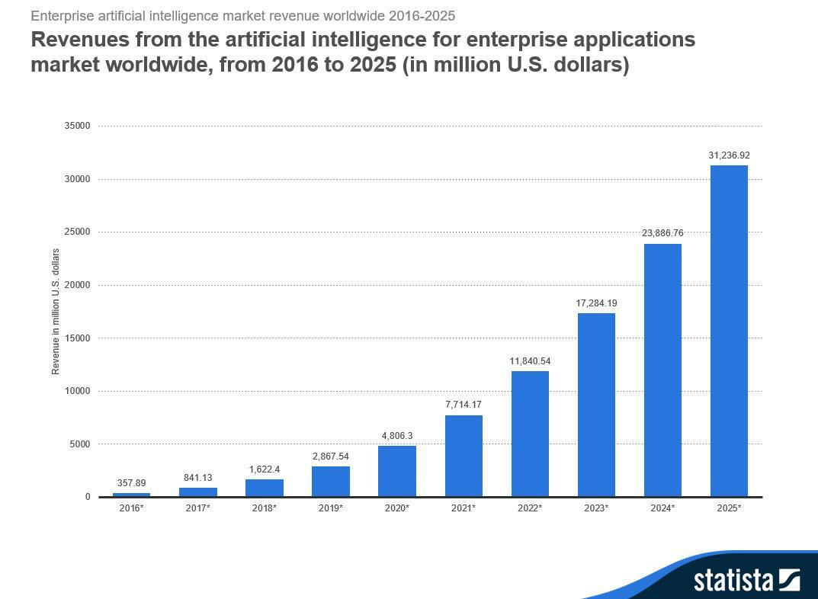

Slide 13
Artificial intelligence is a term used to describe a variety of technologies These
Artificial intelligence (AI) is a term used to describe a variety of technologies. These include machine learning, computer vision, natural language processing (NLP), and machine reasoning, among others.

Slide 14
As these examples illustrate the concern about advanced AI isnt malevolence but
Artificial intelligence (AI) is the ability of machines to mimic human cognition. AI functions include all aspects of perception, learning, knowledge representation, reasoning, planning and decision making.

